Slide 1



Data model and tagging

Slide 2
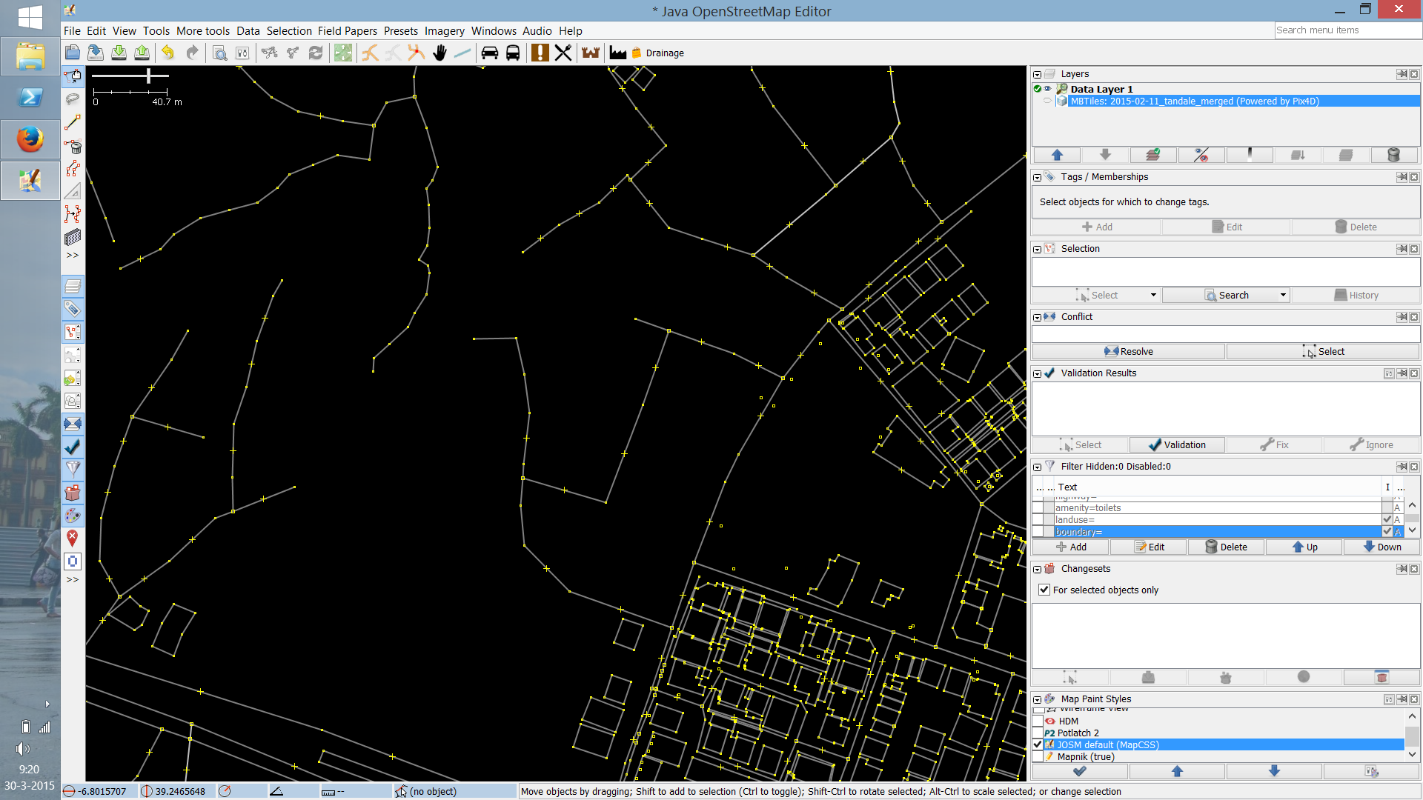
Why tagging?

Slide 3
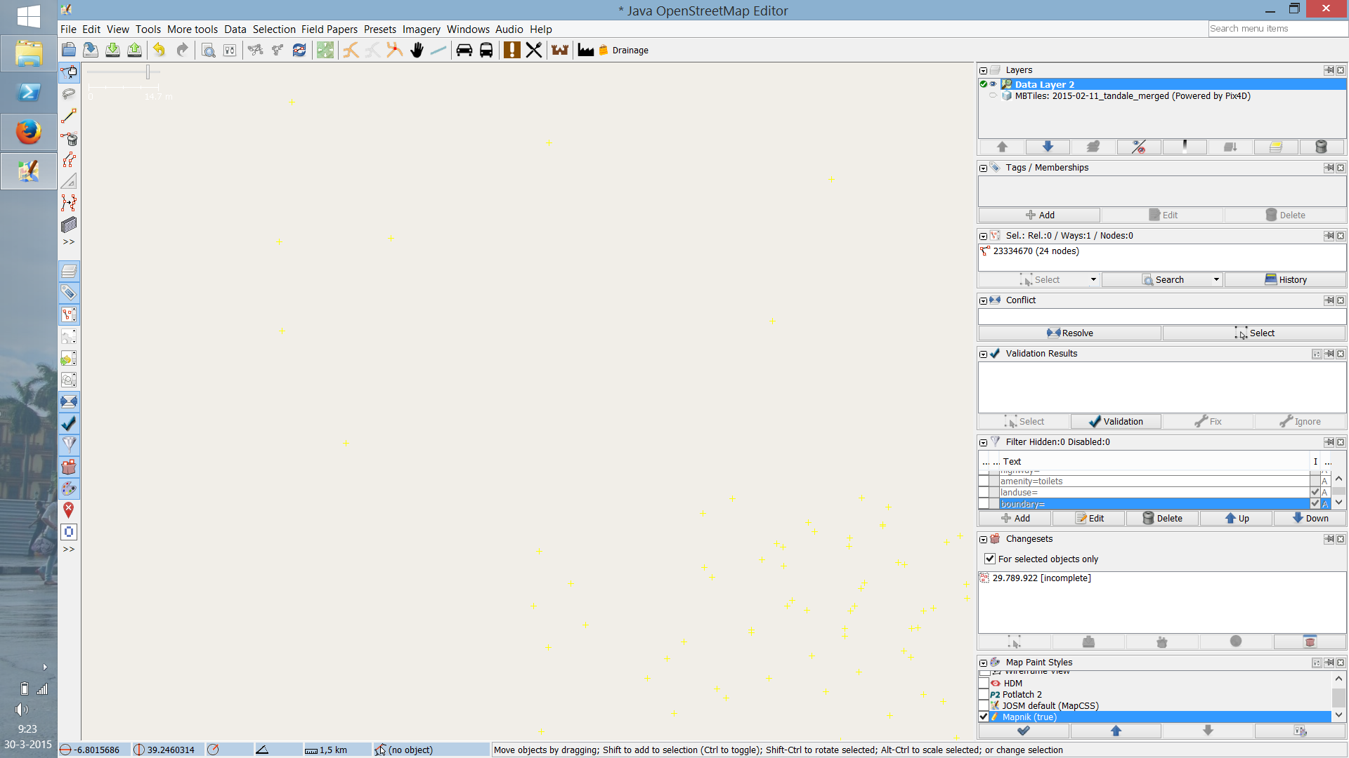
.. otherwise the map will be like this:

Slide 4
Why tagging?
Is this line… a road? A river? A railroad?
Add meaning
Communication and agreement
to viewers
to other mappers
to other computers/APIs
to the map renderer!

Slide 5
What is a tag exactly?
“a label attached to someone or something
for the purpose of identification, or to give
other information.”

Slide 6
Categorize, to add information that is useful for:
understanding of the map
planning
routing
querying
many other use cases!

Slide 7
In OpenStreetMaps:
a key describes a property of a feature,
specifying one or more values
Each feature should have one or more tags!

Slide 8
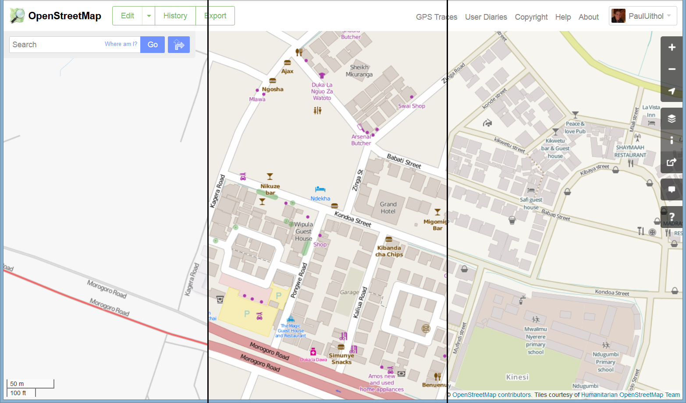
Renderers

Slide 9
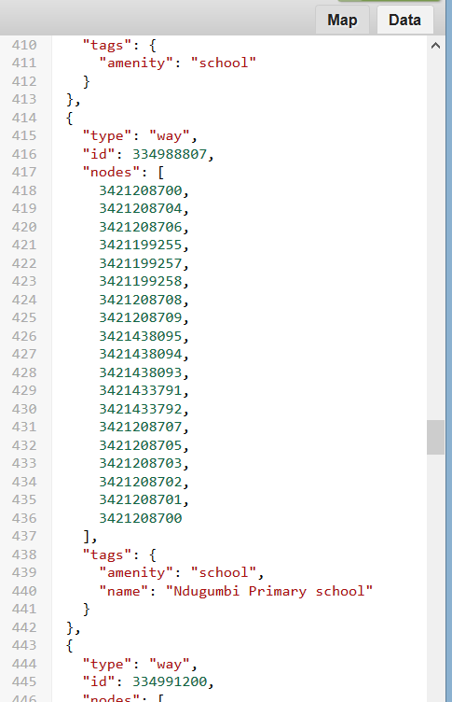
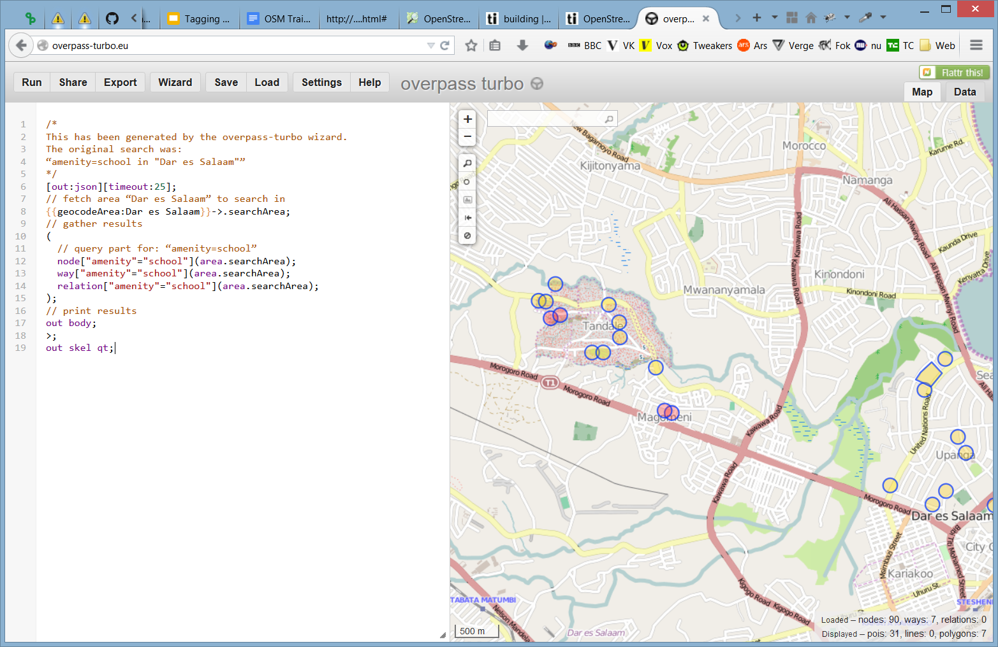
API
http://overpass-api.de/
http://overpass-turbo.eu/

Slide 10
OSM Uganda Data Model and Tagging
Financial infrastructure
1.1 Mobile Money Agents
1.2 Banks
1.3 ATMs
1.4 Credit Institution
1.5 MDI
1.6 MFI
1.7 SACCO
1.8 Bureau de Change
1.9 Money Transfer Services
1.10 Post Office
1.11 Banking agent

Slide 11
Other Features
2. Health facilities
3. Educational facilities
4. Streets

Slide 12
1.1 Mobile Money Agents
amenity = mobile_money_agent
name = <name of handler>
network = <operator>
operator = <owner of mm shop>
If multiple use semi colon delimited
opening hours = <days/times of opening>
e.g. “Mo-Su 08:00-22:00”, “24/7”
phone = <phone number>

Slide 13
1.1 Mobile Money Agents (continued)
addr:city = <city>
addr:street = <street name>
addr:housenumber = <house number>
shop = <shop type>
If an agent also sells other goods.
eg. butcher, clothes, convenience
male = yes (if handler is female)
female = yes (if handler is male)

Slide 14
1.2 Banks
amenity = bank, banking_agent
name = <name of bank branch>
operator = <bank name>
opening_hours = <days/times of opening>

Slide 15
1.3 ATMs
amenity = atm
name = <name of ATM/location>
network = <ATM network>
e.g Visa, Mastercard, Maestro, Interswitch
operator = <bank/credit institution/MDI name>
opening_hours = <days/times of opening>

Slide 16
1.4 Credit Institution
amenity = credit_institution
name = <name of CI branch>
operator = <institution name>
opening_hours = <days/times of opening>

Slide 17
1.5 MDI
amenity = microfinance_bank
name = <name of branch>
operator = <MDI name>
e.g FINCA Uganda, Pride Microfinance, UGAFODE Microfinance, EFC Uganda
opening_hours = <days/times of opening>

Slide 18
1.6 MFI
amenity = microfinance
name = <name of branch>
operator = <MFI name>
opening_hours = <days/times of opening>

Slide 19
1.7 SACCO
amenity = sacco
name = <name of branch/location>
operator = <if part of a brand>
opening_hours = <days/times of opening>

Slide 20
1.8 Forex Bureau
amenity = bureau_de_change
name = <name of branch>
operator = <operator name>
opening_hours = <days/times of opening>

Slide 21
1.9 Money Transfer Services
amenity = money_transfer
name = <name of bank/agent branch>
network = <network name>
eg. Western Union, MoneyGram, MicroPay, EzeeMoney, Remit, etc
operator = <bank/agent name>
opening_hours = <days/times of opening>

Slide 22
1.10 Post Office
amenity = post_office
name = <name of bank branch>
operator = <bank name>
opening_hours = <days/times of opening>

Slide 23
2. Health facilities
building = hospital
name = <name of building>
amenity = <clinic>or <doctors> or <hospital>
building:levels = <number of levels in the building> (the ground floor is 1!)
building:material = <building material>
e.g brick, cement_block, concrete, loam, metal, plaster, wood
opening_hours = <days/times of opening>
addr:city = <city name>
addr:street = <street name>

Slide 24
3. Educational facilities
building = school
name = <name of school>
amenity = <college> or <kindergarten> or <school> or <university>
building:levels = <number of levels in the building>
building:material = <building material>
opening_hours = <days/times of opening>
addr:city = <city name>
addr:street = <street name>
addr:housenumber = <address number of the building>
eg. 25 or 19A

Slide 25
4. Roads
highway = primary, secondary, tertiary, unclassified, residential, footway
name = <name of street>
surface = asphalt, concrete, unpaved
smoothness = good, intermediate, bad, very_bad, horrible = width = <number> (in meters of street width)
oneway = yes, no
(direction of traffic, NOT the number of lanes!)
bridge = yes, viaduct (add layer=1)

Slide 26
Tagging guidelines
When to tag a mobile money agent?
Fixed location; not moving among traffic, for example
What if other services are offered as well?
Tag as `shop=*` if selling goods
If for example payway, add another point with `amenity=money_transfer`, `network=PayWay`

Slide 27
Data access
For more tags see
http://wiki.openstreetmap.org/wiki/Map_Features
http://taginfo.openstreetmap.org/
For querying OpenStreetMap data
https://overpass-turbo.eu/
Example:
node
[amenity=money_transfer][operator~'Airtel']
({{bbox}});
out;

